Slide 1
Canyon Springs
National College Signing Week
April 24-27, 2017
CSHS Seniors Celebrate Their Futures

Slide 2
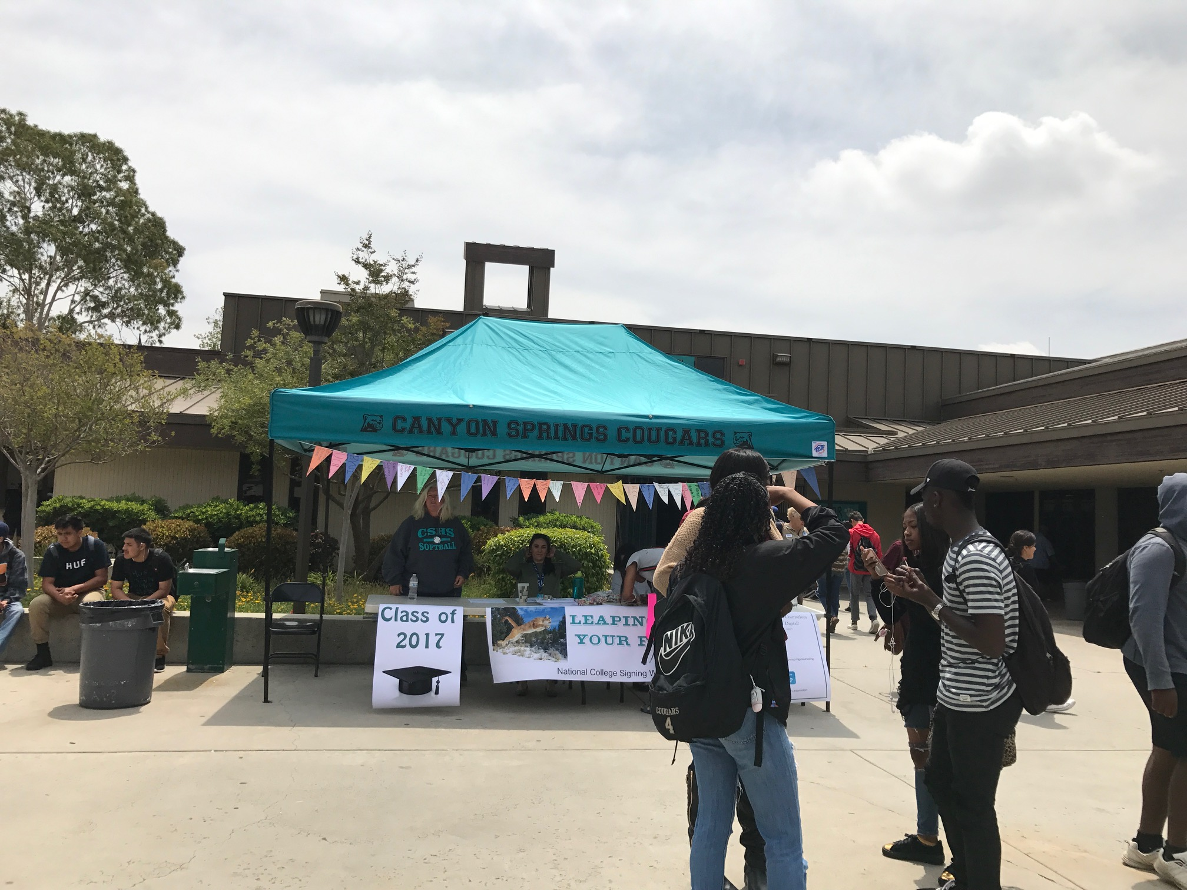
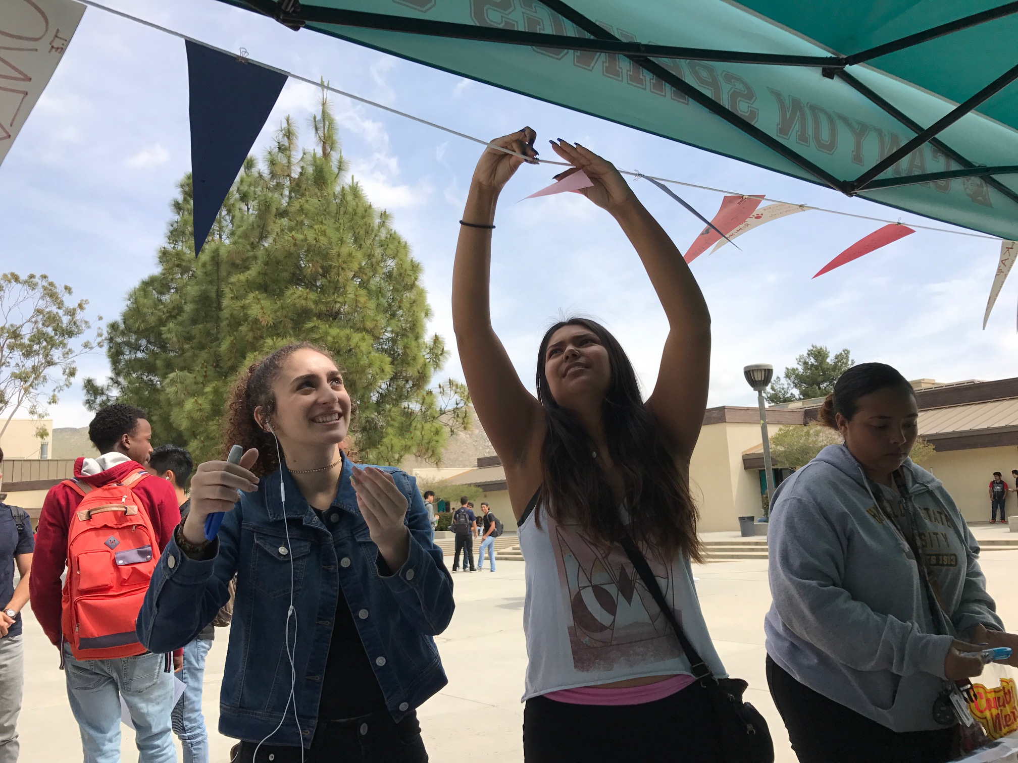
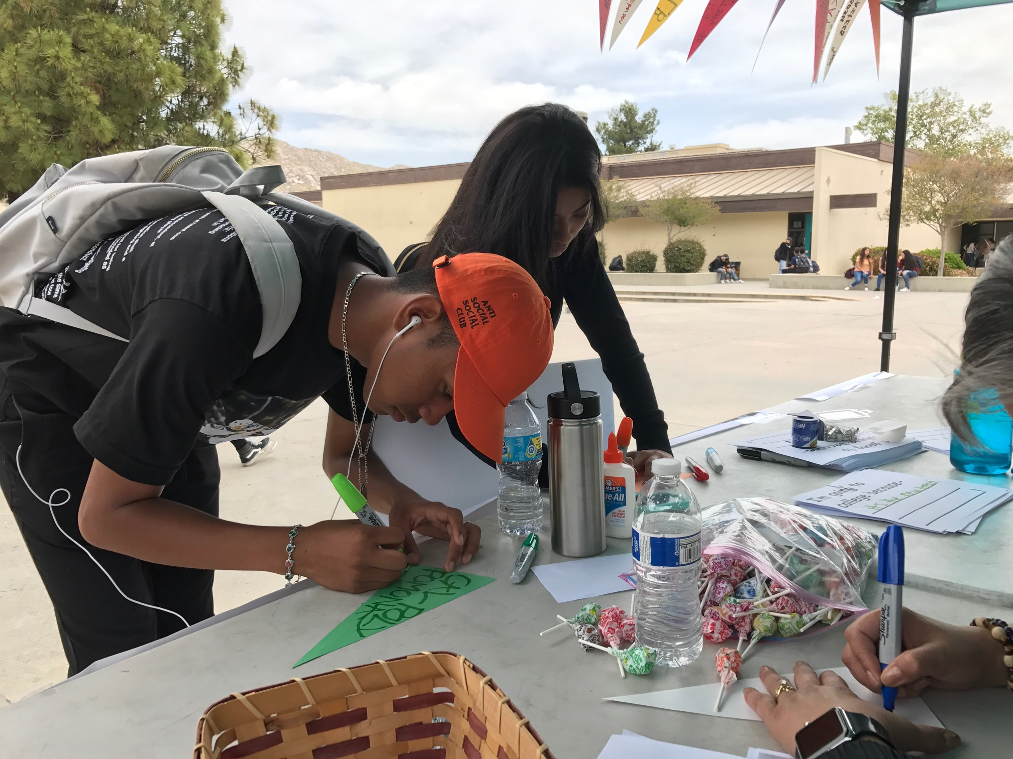
College Pennants
At lunch time seniors decorated pennants with their school of choice and hung them up. 75-100 students participated in the lunch time activity.

Slide 3
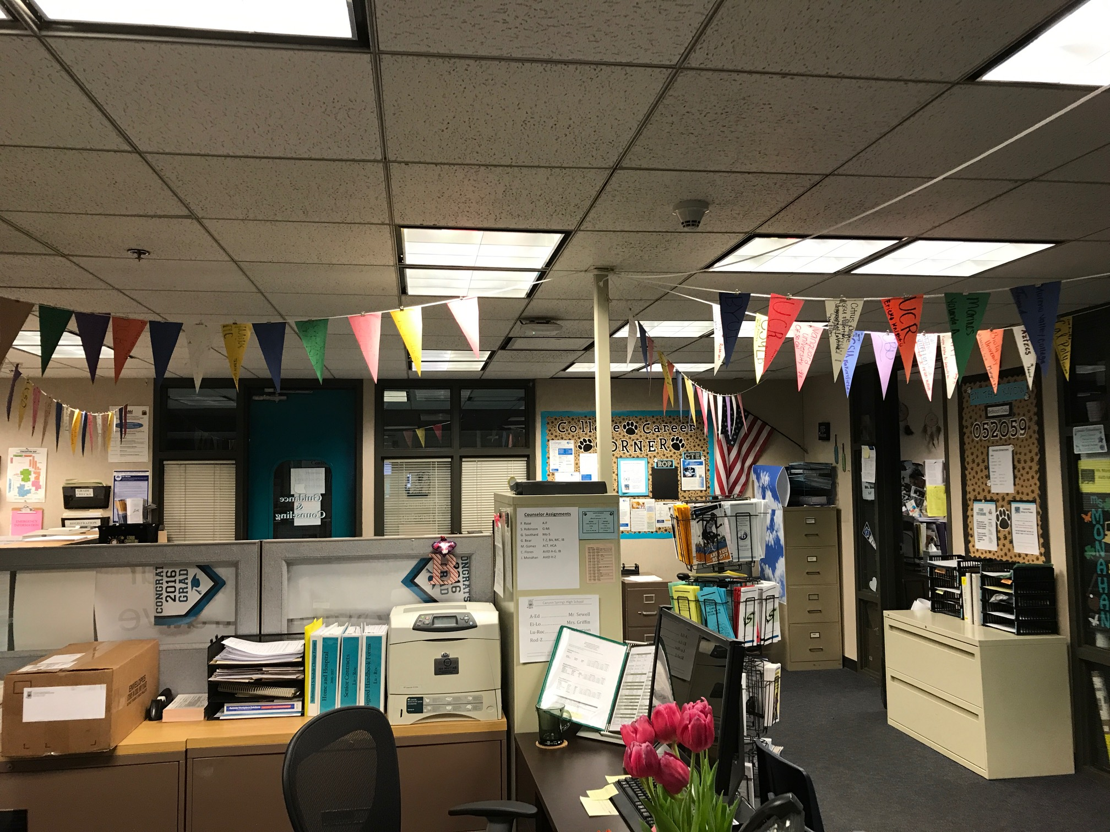
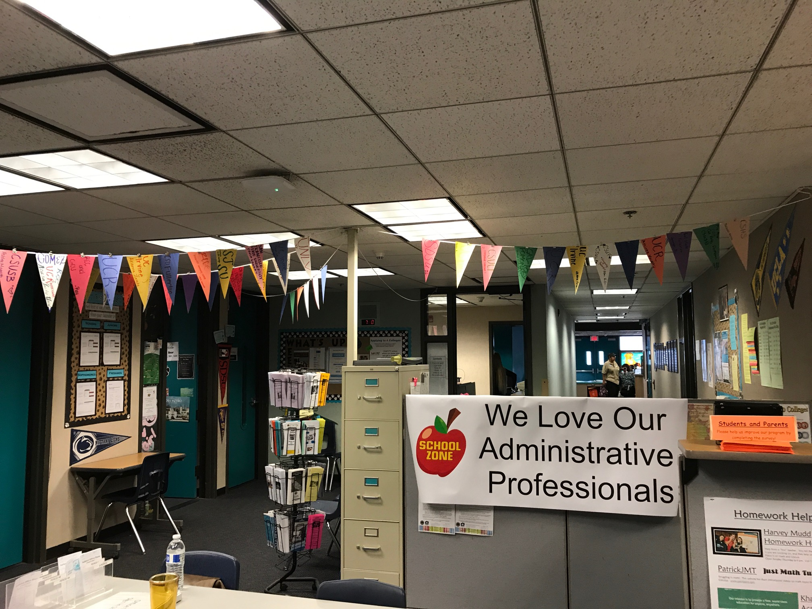
College Pennants
Showcased in Guidance office
Pennants hang in the Guidance Office. A senior can still fill one out and put it up if they missed the week’s activities.

Slide 4
I’m Going To College Because . . .
Seniors also completed the sentence “I’m Going to College Because . . .” (Or “I’m enlisting Because . . .)

Slide 5
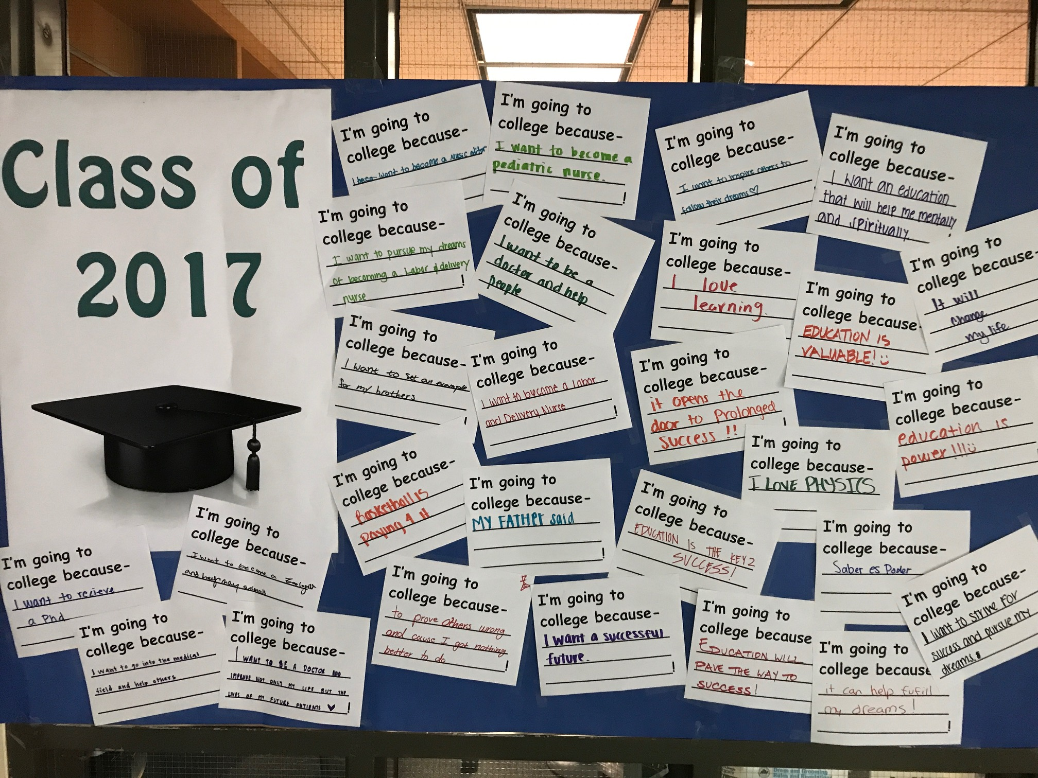

I’m Going to College because . . .
Showcased by Resource Center and on Guidance Instagram
@canyonspringscounseling

